Slide 1
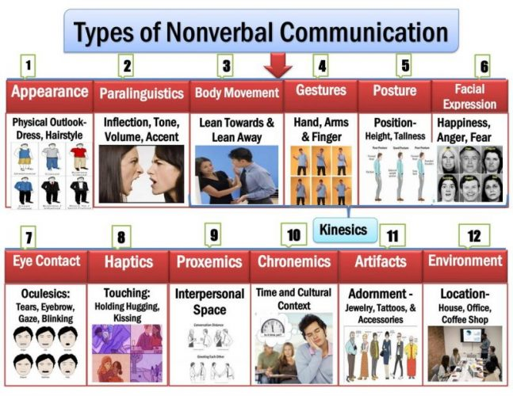

Slide 2
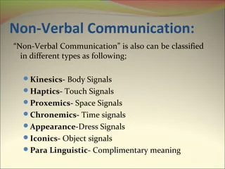

Slide 3
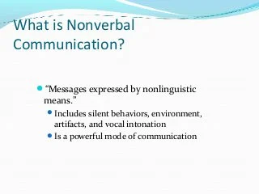

Slide 4
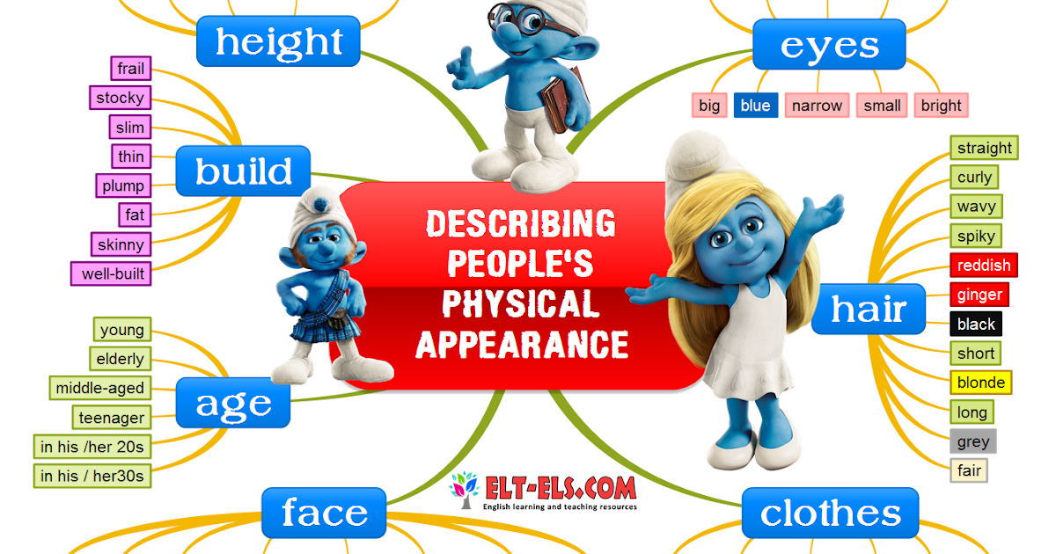
Appearance

Slide 5
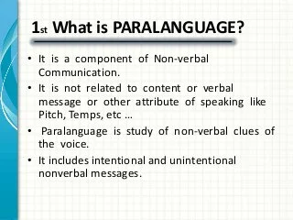
Paralinguistic

Slide 6
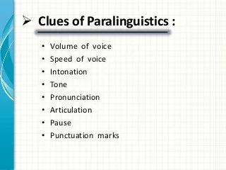

Slide 7
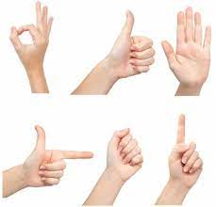
Gesture
A movement of the body, hands, arms, or head to express an idea or feeling:

Slide 8
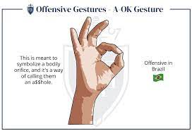
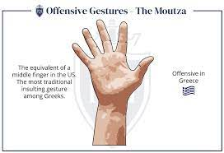

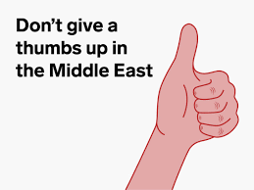
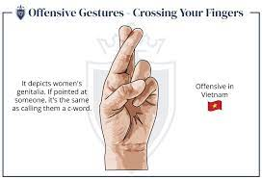
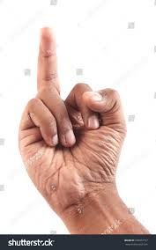
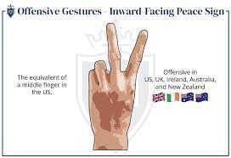
Offensive Gesturers

Slide 9
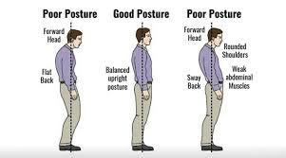
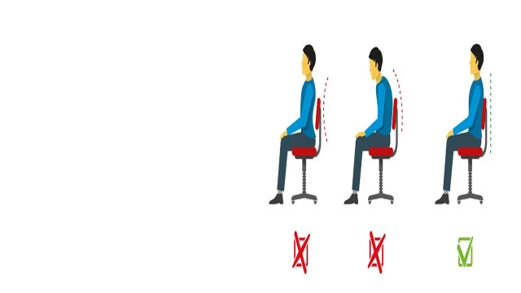
Posture
A position of the body, or the way in which someone holds the body when standing, sitting, or walking:

Slide 10
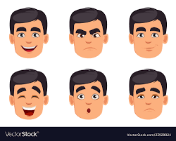
Facial Expression

Slide 11
Eye Contact
There is one simple thing you can do to enhance your impact as a presenter and persuade others to see your point of view, it’s sustained, meaningful eye contact with your audience.
Positive eye contact helps you build rapport with your audience and keeps them engaged with your presentation. It also gives them a sense of involvement and conveys your message on a personal level.

Slide 12
Benefits OF Eye Contact
Positive eye contact helps you build rapport with your audience and keeps them engaged with your presentation. It also gives them a sense of involvement and conveys your message on a personal level.
Improves your concentration
Establishes a connection with your audience
Projects authority and confidence
Facilitates engagement with the audience

Slide 13
Cultural Difference in eye contact
Keep in mind that the length of eye contact varies by culture. Some cultures use eye contact more than others. If you're giving a presentation in a culture other than your own, make sure you investigate the cultural norms and behaviour of the people in your audience.
For example, in Middle Eastern cultures, it’s considered inappropriate for people of the opposite sex to look each other in the eye, as that can denote a romantic interest between them. In Asian cultures, however, eye contact is seen more as a sign of disrespect, especially when the contact is made by a subordinate to his or her superior. This is because most Asian countries are largely authoritarian.

Slide 15

Haptics
Haptics is a form of non- verbal communication using a sense of touch. Some forms of Haptics communication is Handshake, or a gentle pat on back, or a high-five. The sense of touch allows one to experience different sensations.

Slide 16
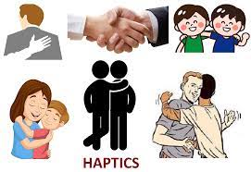
Haptics can be categorized into
Professional
Social/ Polite
Friendship/Warmth
Love

Slide 17
Managers and co-workers should know the effectiveness of using touch while communicating to their sub-ordinates, but need to be cautious and understand how touch can be misunderstood.
A hand on shoulder may supportive for one person whereas for other person it may be negative for another.
We use handshake to gain trust and introduce our self.
Haptics rules changes according to different cultures, context and status of relationships.
In US the main form of greeting is handshake, though with friends they may hug each other. In Japan people bow at each other upon meeting and touching is rather considered rude.
In Latin America kissing either on one or both cheeks is considered as form of greeting.

Slide 18
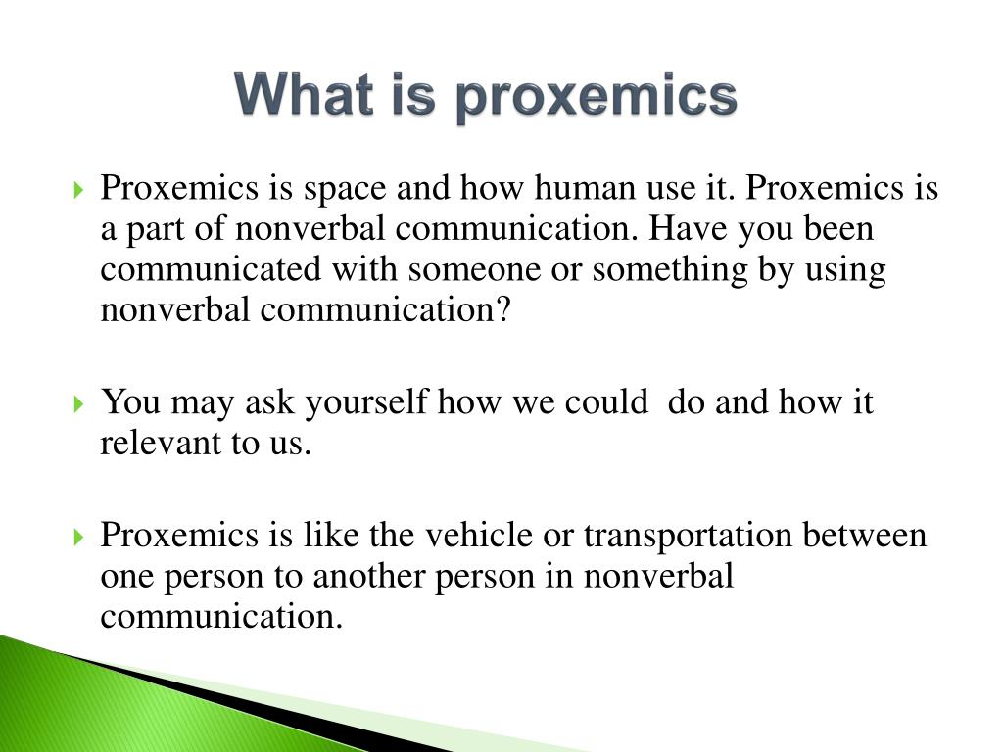

Slide 19
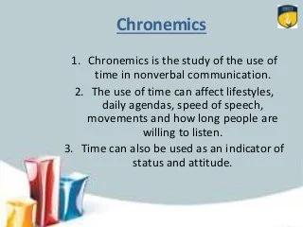

Slide 20
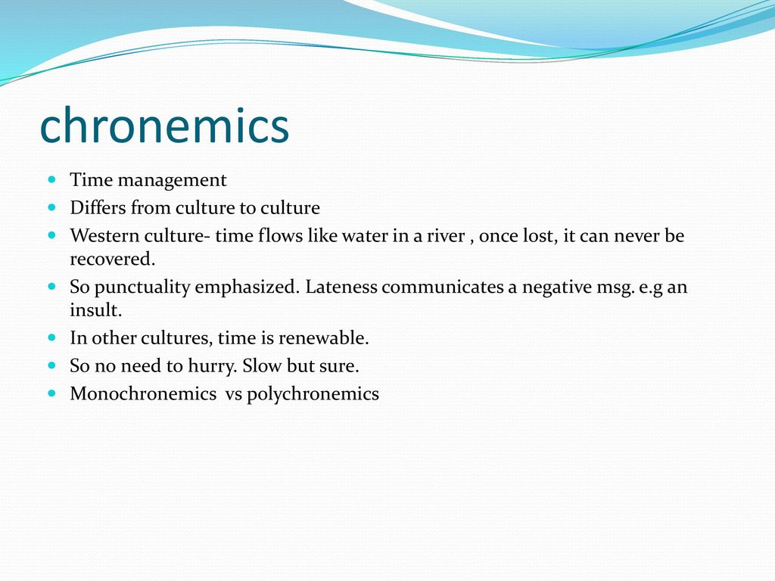

Slide 21
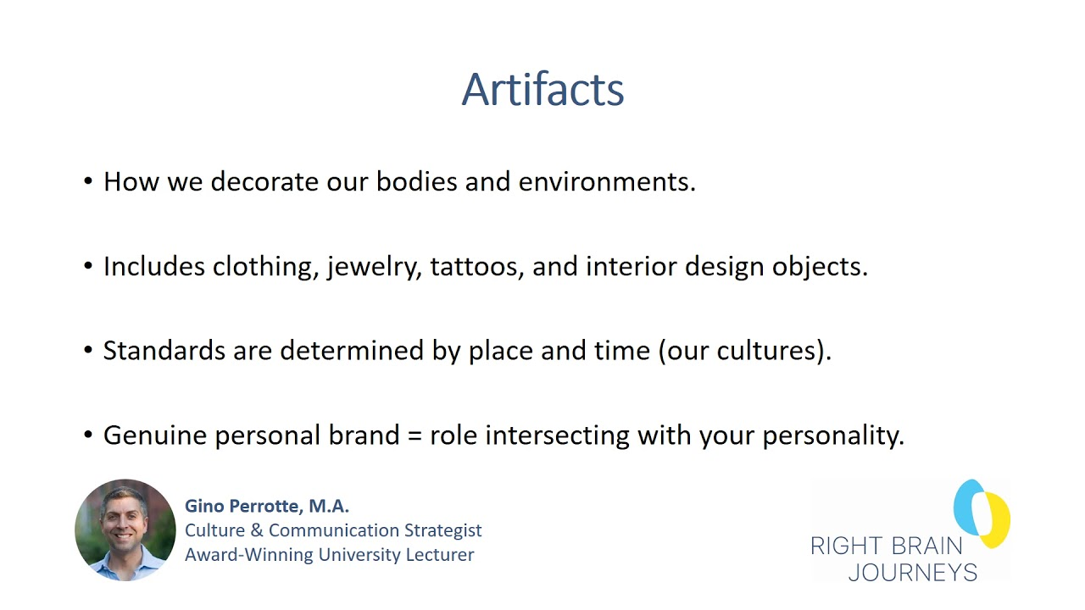

Slide 22
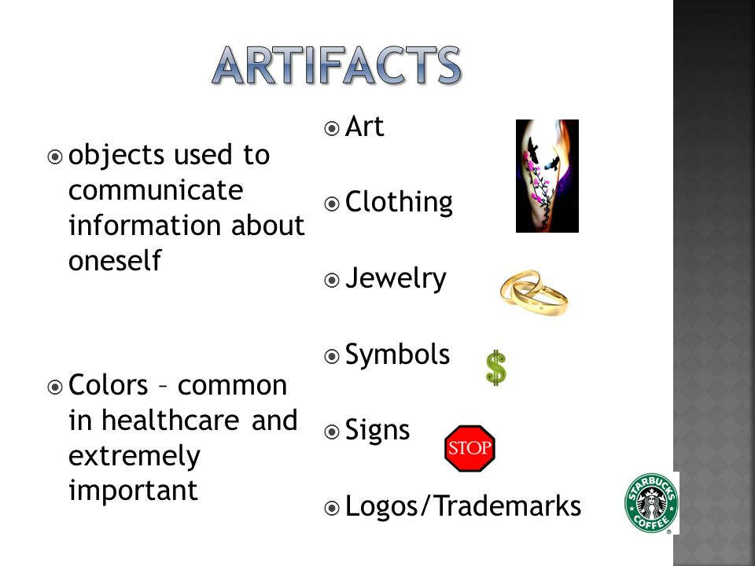

Slide 23
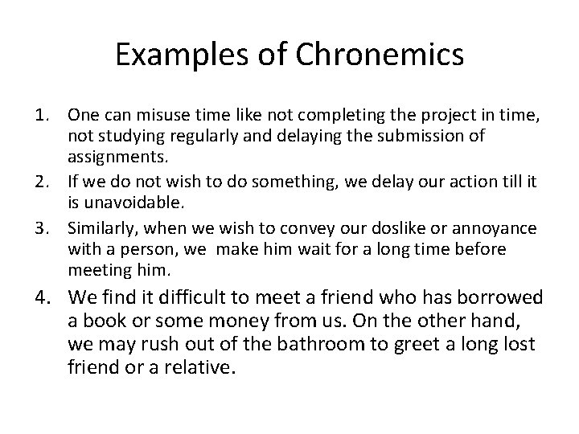

Slide 24
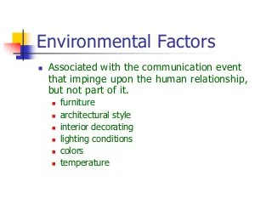

Slide 25


